Slide 1
Tabletop Exercise: Dynamic, Effective Preparedness for Violent Intruder Emergencies

Slide 2
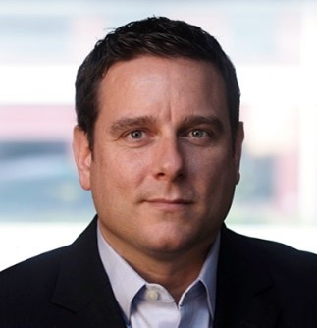
Welcome
Rob Burton
Co-founder and Managing Director
Nick Hill
Director of Intelligence Services
Notes:
Chris: Introductions

Slide 3
Educate
Today’s Goals
Connect
Share
Notes:
Chris
Today will be really successful when we all engage!
Rules of the Game:
Please speak up. Interrupting is better than full quiet. (silence)
--
Education and Share:
* We all determine our own applicability of best practices. But hopefully this is at least inspiriting or challenging on BP
Connection:
Personal Brand: Nod toward career coaching. Good for others in the space to know your name for 2 reasons:
Answering questions (evacuating? Policies?)
Professional networking / career. (JA example from Wal Mart)

Slide 4
About BV Robotics
Notes:
COMPANY & SITUATION BACKGROUND
It’s a cold but sunny February morning in Chicago.
You are a leader at BV Robotics Headquarted in Chicago.
There are 158 employees working at the Chicago office location.
You have 12 additional locations across the US and Canada.
You play a role on the corporate Crisis Management Team CMT.
The company has an emergency notification system throughout the organization.
The Chicago headquarters is under the flight path of Chicago Midway Airport and close to other businesses in the area, as well as a school, church and large mall.
Access control is known to be good at the Chicago headquarters.
There is an unarmed security force of two working shifts.

Slide 5
General Manager (Leader)
Operations Manager
Logistics Manager
Docking / Shipping Manager
Human Resources
Legal
Safety and Security Manager / Emergency Coordinator
Public Relations / Communications Manager
Sales and Marketing Manager
Roles for Today's Exercise
Notes:
Chris to pass out tent cards
Rob- explain tent cards on table

Slide 6
Inject Period One
The Unfolding Situation
Inject 1.1 – Previous Month
Your company has received more than a dozen threatening letters and emails from an anonymous source over the past six months. This correspondence has been escalating, changing from generalized threats to specific statements threatening the safety of your executive leadership by name.
Local and federal law enforcement agencies are investigating these threats but have been unable to establish any solid leads.

Slide 7
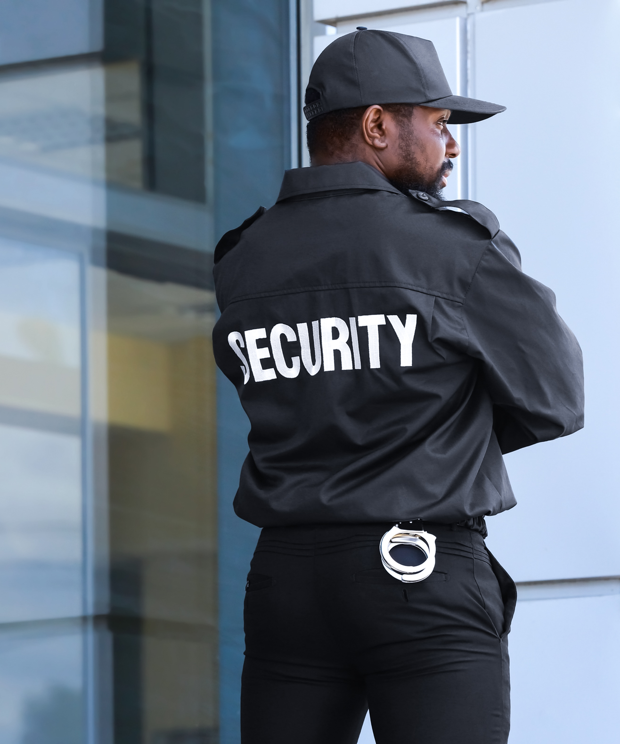
Inject Period One
The Unfolding Situation
Inject 1.2 to 1.3 – Previous Week
Inject 1.2
Your internal security department has engaged several external threat assessment consultants to assess this situation. Executive Protection services have been engaged for all individuals named in the threats, and a plan to update the physical security of your headquarters building is in final review before moving forward for implementation. There has been significant concern from company leadership about the cost associated with any changes to the building.
Inject 1.3
The local police are working closely with your security department and have increased their presence around your headquarters building, including using cameras and drones. Several employees have complained to their ombudsman that “...it feels like we’re working in a prison.”

Slide 8
Inject Period One
The Unfolding Situation
Discussion Questions
1
How does your organization monitor and analyze threat intelligence, and how well is it integrated into security protocols and risk management?
How would your current security measures address this type of threat, and how effective do you think they would be?
How are your employees trained to recognize and report suspicious activity in and around your facilities?
How does your organization collaborate with local authorities to stay informed about potential threats and coordinate preventative and protective strategies?
How would your organization respond to employee concerns that security precautions were invasive and inconvenient?
2
3
4
5
Notes:
Take a screenshot for breakout groups
10min

Slide 9
BREAKOUT
for Inject Period One
Notes:
Talk about key takeaways from breakout session (2-3 points)

Slide 10
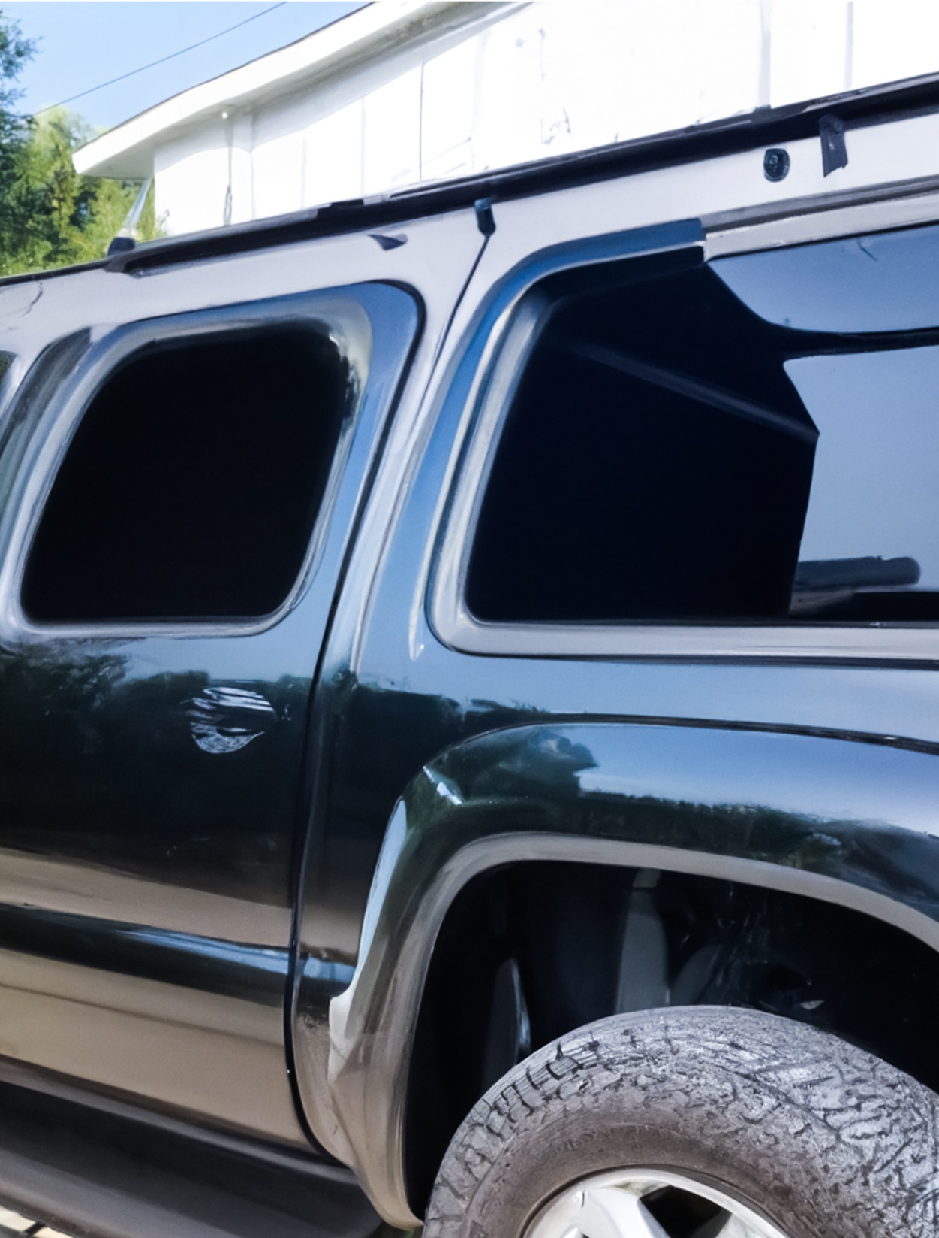
Inject Period Two
The Ongoing Emergency
Inject 2.1 to 2.3 – Current Day, 9:20-9:35 AM
Inject 2.1 – 9:20 AM
A full-sized pickup truck with darkly tinted windows and a camper body on the bed has just jumped the curb in front of your headquarters building and rammed the front façade. The truck broke through the main entry doors, crushed the reception desk, and is resting against the central elevator column for the building.
Inject 2.2 – 9:25 AM
The truck driver has exited the vehicle wearing black tactical clothing and body armor. They are armed with an assault rifle and opened fire on the people in the reception area before barricading themselves back in the camper.
Inject 2.3 – 9:35 AM
First responders are on the scene. Law enforcement officers have established a perimeter and are searching the rest of the building while isolating the scene in the first floor reception area.

Slide 11
Inject Period Two
The Ongoing Emergency
Inject 2.4 – Current Day, 9:45 AM
BREAKING NEWS

Slide 12
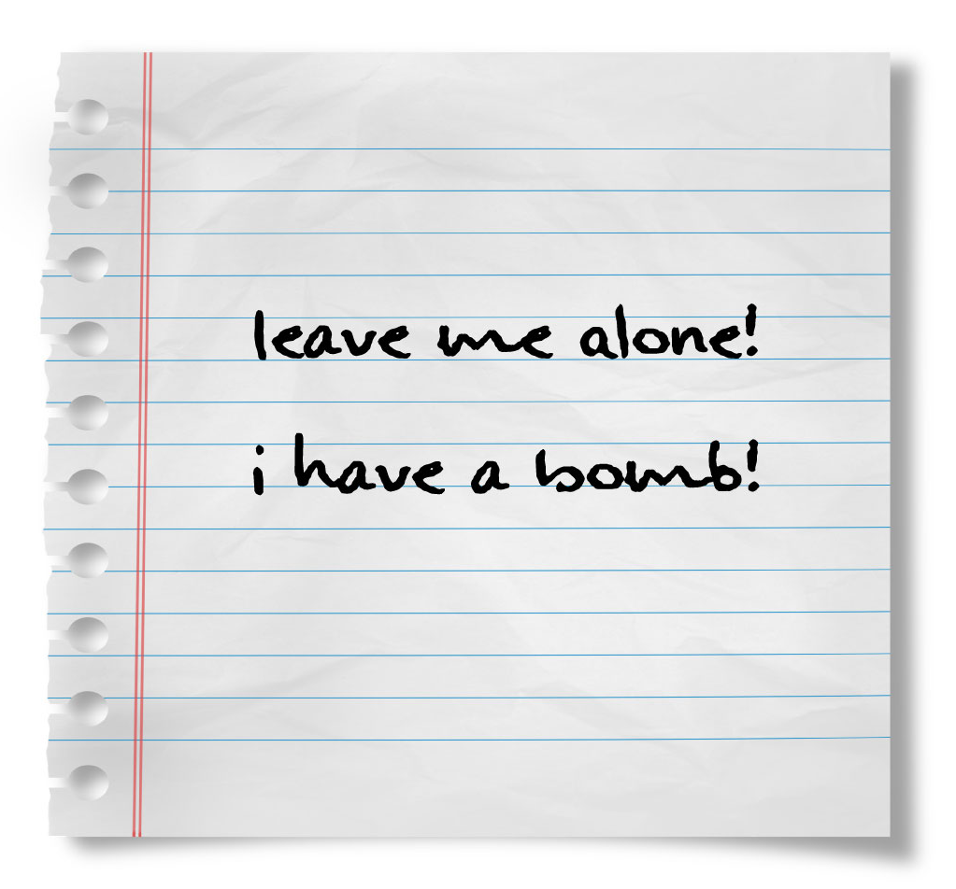
Inject Period Two
The Ongoing Emergency
Inject 2.5 – Current Day, 9:50 AM
The building is being evacuated through emergency exits away from the reception area. There are 14 employees currently unaccounted for. Tensions escalate as the law enforcement officers securing the scene discover a hand-lettered note stating, “Leave me Alone! I have a Bomb!” in the cab of the truck.

Slide 13
Inject Period Two
The Ongoing Emergency
Discussion Questions
1
How are your employees trained to respond to this type of scenario, and how do you think they would actually respond if it occurred?
How would your organization coordinate with law enforcement on this scene, and who is responsible for that coordination?
How would you communicate with your employees and other internal stakeholders during this scenario?
How would you manage communications with external stakeholders, the media, and the public during this scenario?
What policy, plans, and procedures currently exist at your organization to prevent or mitigate this type of scenario?
2
3
4
5
Notes:
Screenshot for breakout
10min

Slide 14
BREAKOUT
for Inject Period Two
Notes:
2-3 takeaways

Slide 15
Inject Period Three
Recovery and Debrief
Inject 3.1 – Current Day, 10:00 PM
The situation is resolved. The truck driver has been neutralized or arrested by law enforcement, and no device was found by the bomb squad. All 14 of the missing employees have been accounted for.
9 were killed during the incident, and 5 were located at neighboring businesses after having fled the scene when the truck first entered the building.

Slide 16
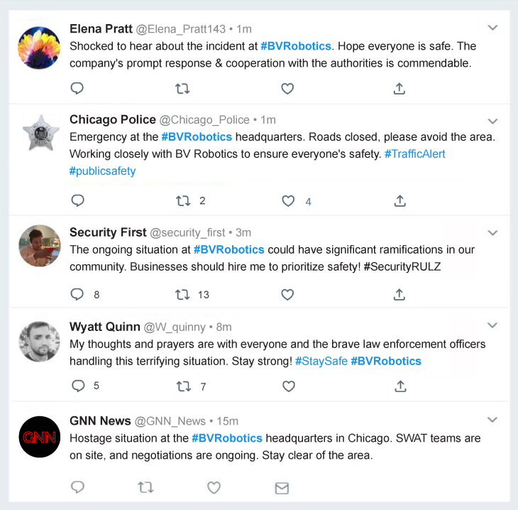
Inject Period Three
Recovery and Debrief
Inject 3.2 – Following Day, 10:00 AM
SOCIAL MEDIA
#BVRobotics

Slide 17
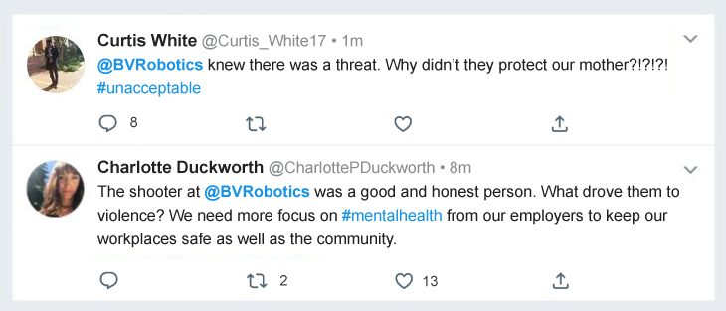
Inject Period Three
Recovery and Debrief
Inject 3.3 – One Week Later
SOCIAL MEDIA
#BVRobotics
Families of the employees who were killed express concerns over safety and security, leading to public relations challenges.

Slide 18
Inject Period Three
Recovery and Debrief
Inject 3.4 – One Month Later
The headquarters building has been reopened for business. An internal review is launched to examine security protocols and emergency response measures, identifying areas of potential weakness.

Slide 19
Inject Period Three
Recovery and Debrief
Discussion Questions
1
How would this scenario impact your organization?
Would your organization reopen a facility where an incident like this occurred? Why or why not?
How would your organization regain the trust of its employees and stakeholders and ensure that they receive the necessary support to recover from this incident?
Could there be any legal or regulatory actions involving your organization following this incident?
How would your organization participate in the overall evaluation of the response to this incident?
2
3
4
5
Notes:
Screenshot for breakout
10min

Slide 20
BREAKOUT
for Inject Period Three
Notes:
2-3 key points

Slide 21
Well done, and thank you!
Gaps / Issues
Post Exercise
Draft After Action Report (AAR) will be prepared based on:
Identified Gaps
Observations
AAR review
Final AAR and Executive Summary Video
Remediation plan with owners
1
What are some of the more significant issues that you identified?
What is the one thing you will take away from today’s session?
Consider the question while filling out the feedback form.
2
3

Slide 22
For follow-up questions
Products
Mass Notification
Risk Intelligence
Incident Management
Travel Risk Management
Global Risk and Intelligence Services
Watch Center Monitoring
Incident Hotline
Strategic Security Analysis
Custom Tabletop Exercises
Presentation-Ready Crisis Scenarios
Custom Self-Delivered Scenarios
Functional Exercises
Full Scale Exercises
Drills
The International Crisis Management Conference
Crisis Management and Business Continuity Planning
About Us

Slide 23
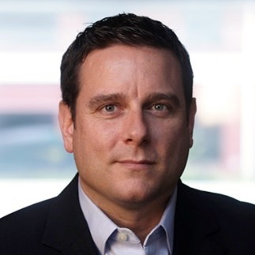
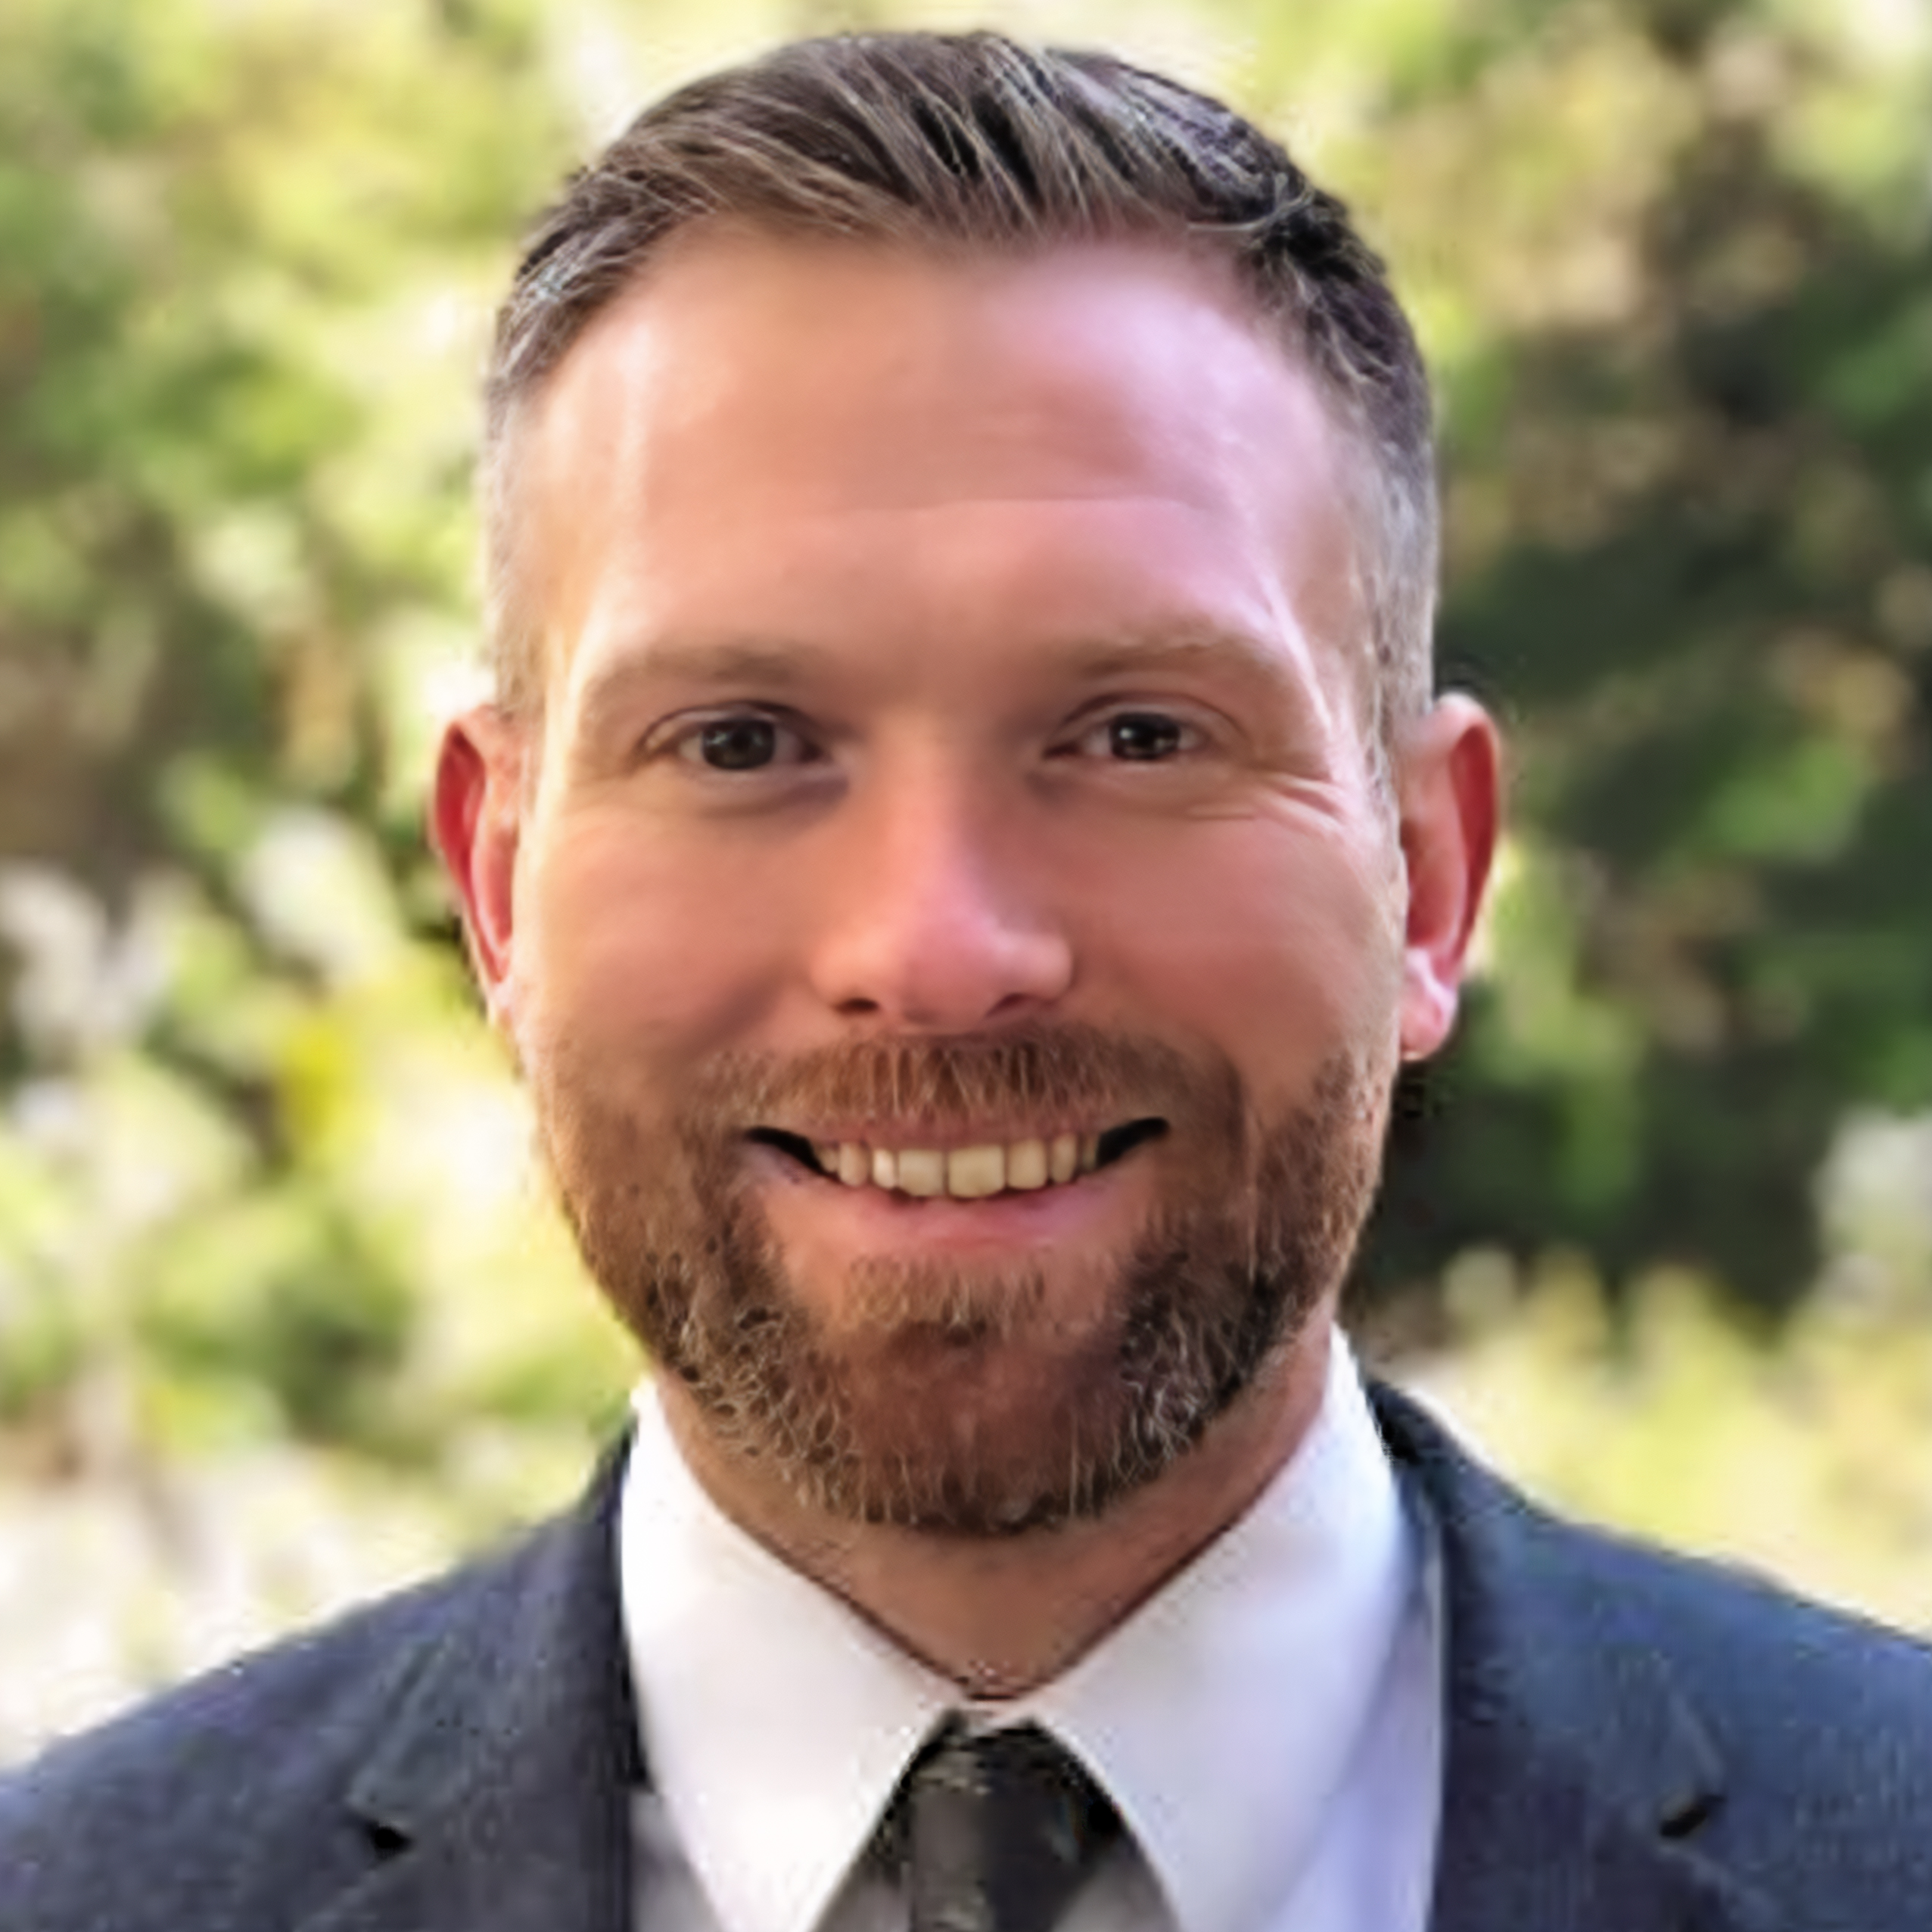
Rob Burton
Co-founder and Managing Director
PreparedEx
Rob.Burton@preparedex.com
Thank you for joining us!
Nick Hill
Director, Intelligence Services
OnSolve
Nick.Hill@OnSolve.com

